Slide 1
Notes and TODO:
Read about InfiniBand
Read about G Series and D Series

Slide 2


A Tale of Two Clouds
A side by side comparison of Microsoft Azure and AWS
Andrew Siemer | Clear Measure
andrew@clear-measure.com
@asiemer

Slide 3




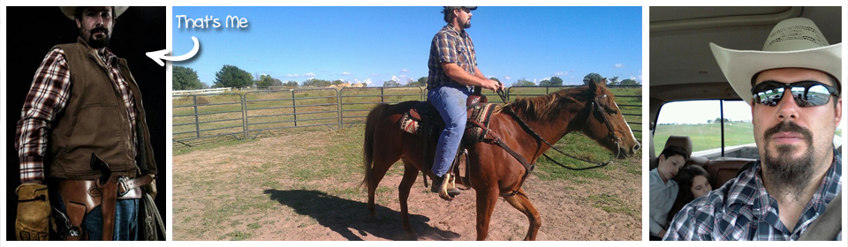


Andrew Siemer
http://about.me/andrewsiemer
ASP Insider
MS v-TSP (Azure)
Azure Advisor Program
Father of 6. Jack of all trades, master of some.
Notes:
Andrew Siemer, I am an ASP Insider, Microsoft virtual technology specialist program, father of 6, and general jack of all trades – master of some!
I enjoy all things texas, obstacle racing, cowboying, and playing with my six kids

Slide 4
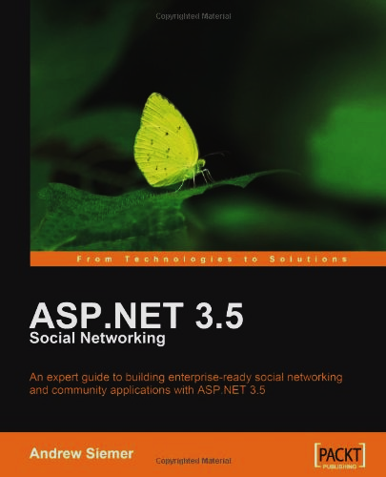
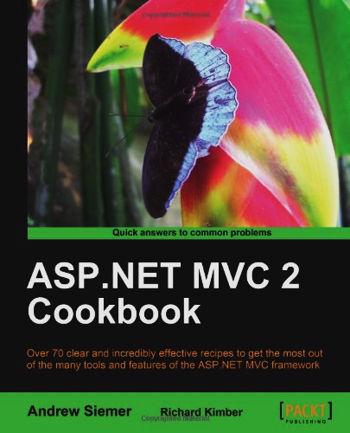
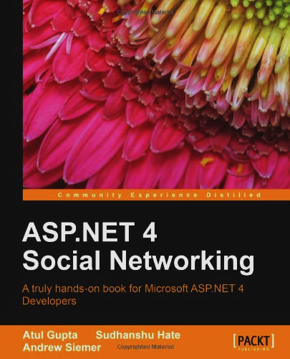

Notes:
I have written several books on the topic of programming in ASP.NET, and one more farming oriented

Slide 5
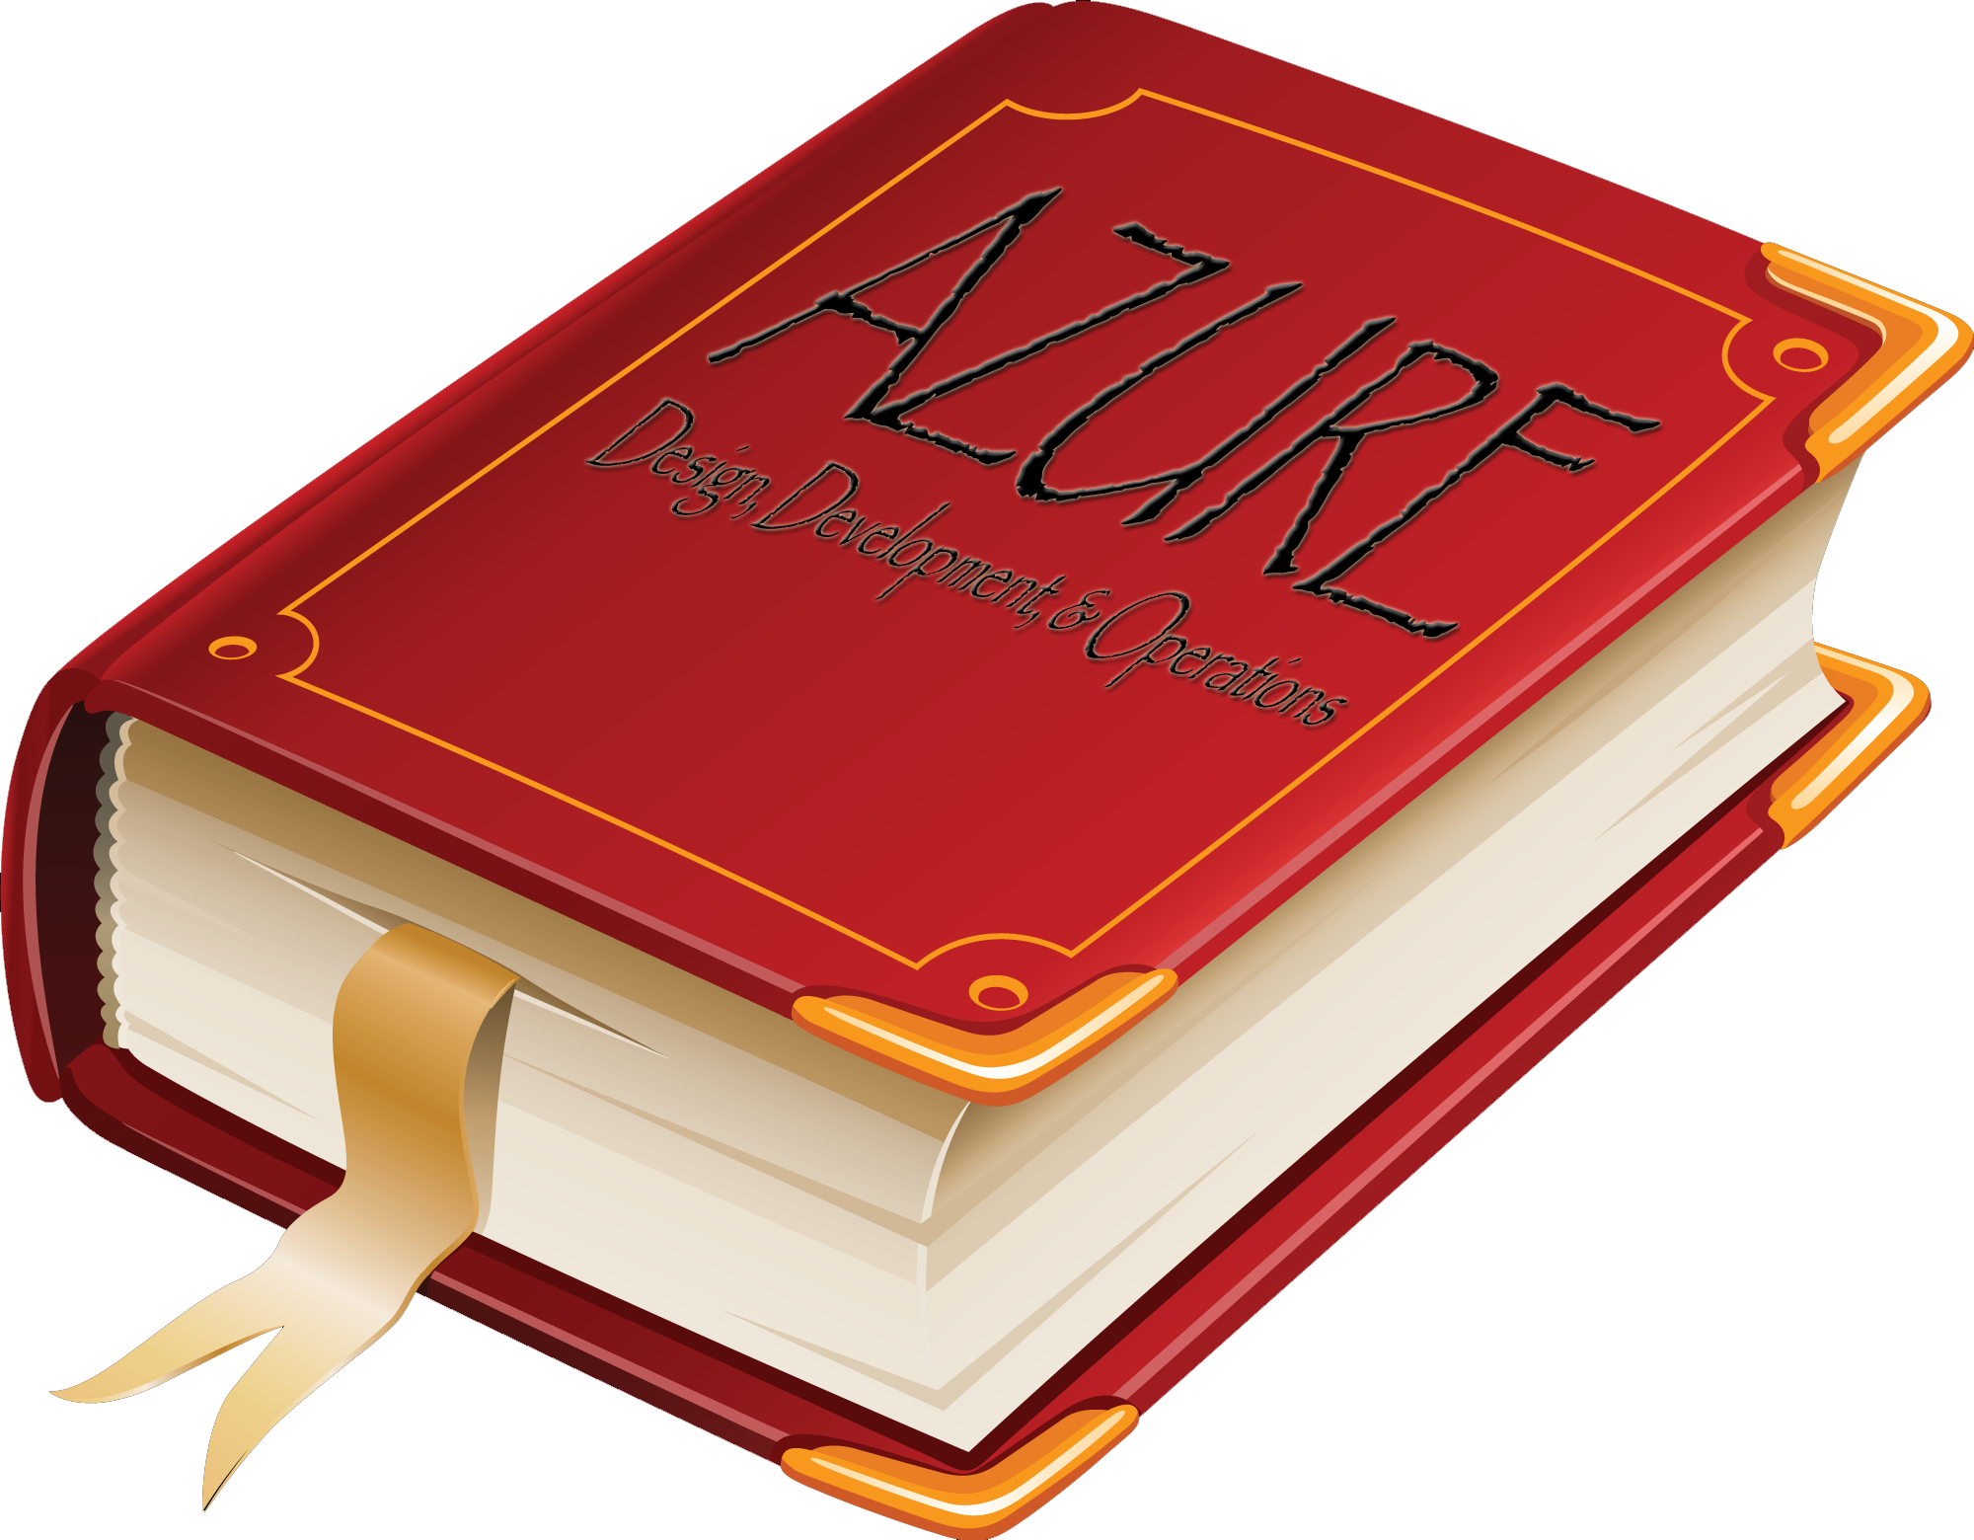
Notes:
I have written several books on the topic of programming in ASP.NET, and one more farming oriented

Slide 6




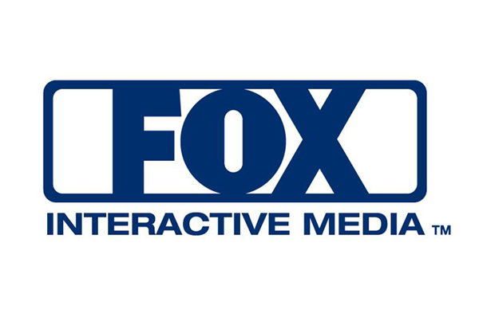
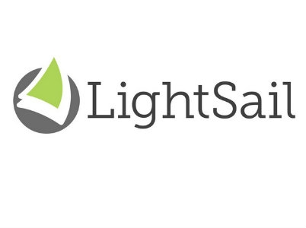





← We are hiring!!!
Notes:
I currently work for Clear Measure in Austin Texas. We are hiring!
I have also worked for companys such as Dell, Callaway golf, and lamps plus.

Slide 7
Introduction

Slide 8
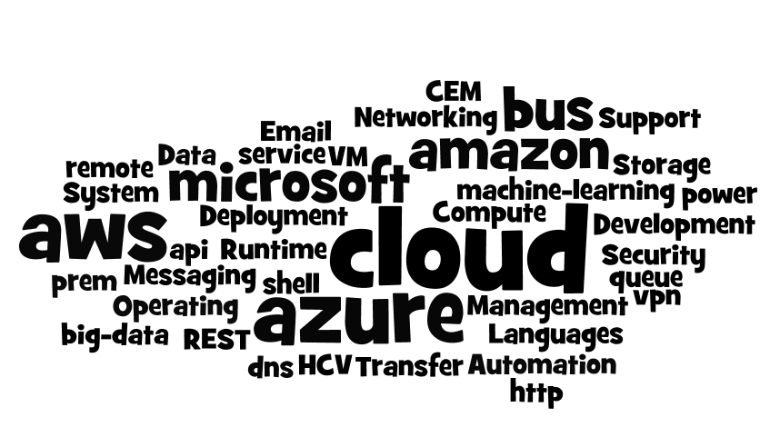
Introduction
Notes:
Today we are going to dig through at a very high level what the Microsoft Azure cloud and Amazon Web Services offer

Slide 9
Introduction
Deployment, Management, and Automation
Compute
Storage
Messaging
Email
Networking
Security
Operating System & Data Transfer
Development Languages and Runtime Support
Notes:
More specifically we are going to look at the following concepts

Slide 10
Quick Caveats
Constantly changing and improving
Very wide offering – didn’t cover everything!
Caching?
Machine Learning?
API Management?
Media?
CDN?
Notes:
As Azure and AWS are the primary competing cloud offerings, they are growing daily, adding new services daily, and CHANGING daily. There are of course some items that are known to be missing, some of which I listed here. But the primary point of this talk is a broad overview to help you pick a path through the world of cloud.

Slide 11
What is a “cloud”
Notes:
So what exactly is cloud?

Slide 12

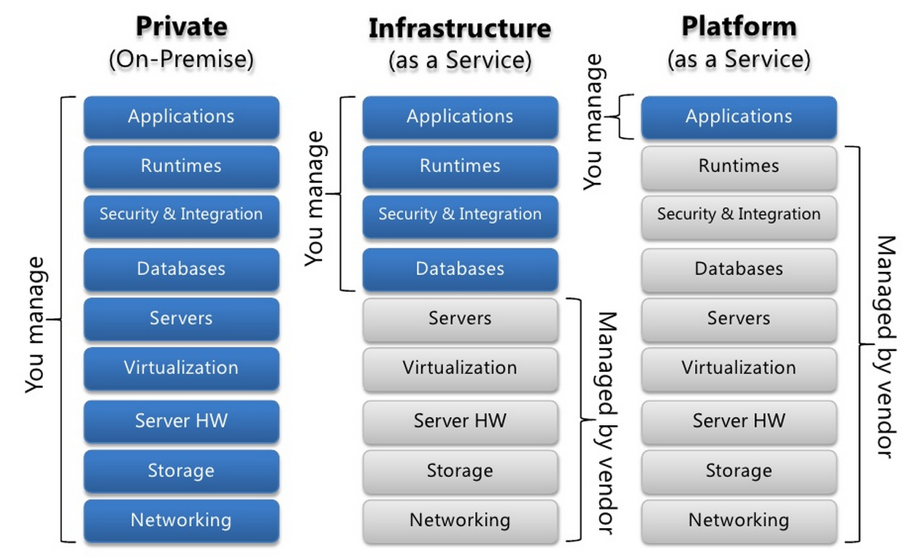
Types of clouds
Notes:
We first need to understand what is available to us
1) Private: you own the app, the run times, and the hardware
2) IaaS: you own the app and the apps direct dependencies
3) PaaS: you own the app, the rest is provided to you

Slide 13
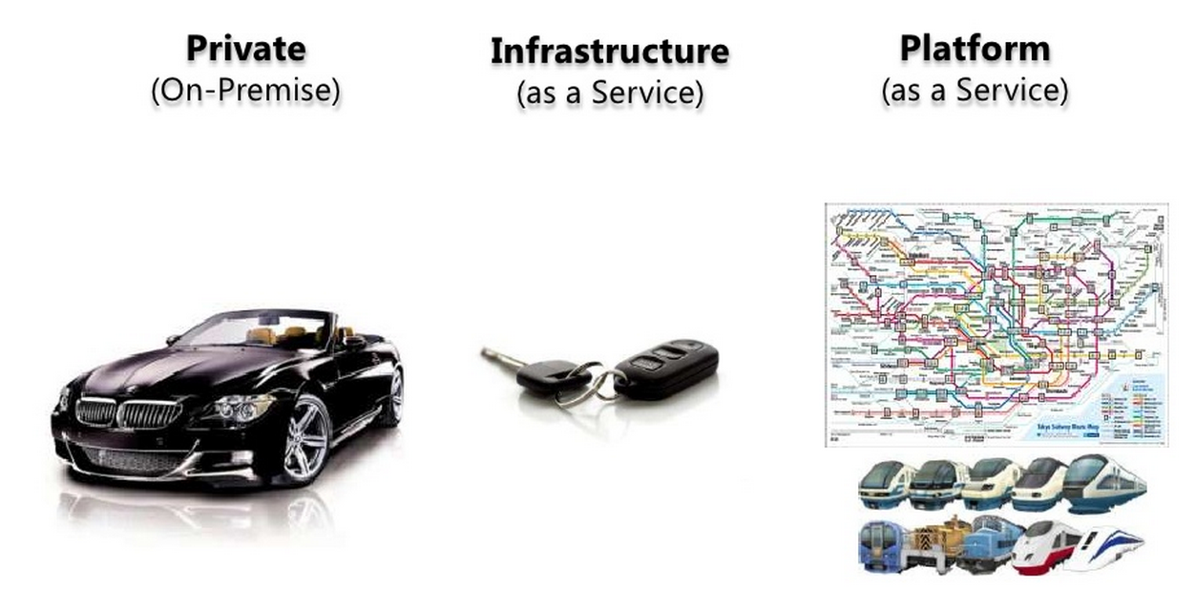
Types of clouds: Private
Think Local Data Center
Notes:
Many company’s have been in the business of owning the whole stack. We often times like to think that as a shiny Beemer. Its yours. You created it. It is meant to be awesome. But let’s face it – running the whole show is hard!

Slide 14
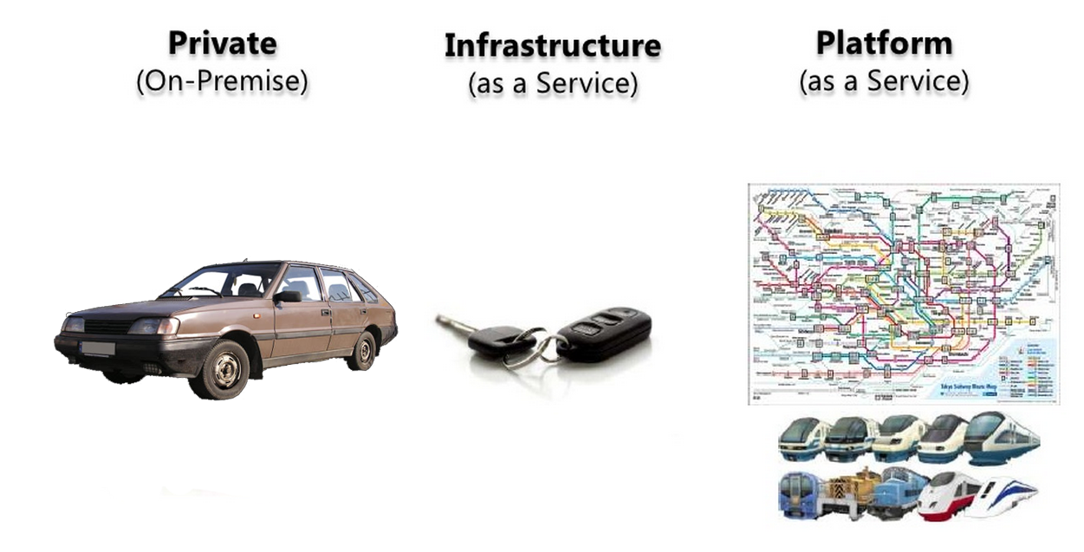
Types of clouds: Private
Think Local Data Center
Notes:
And generally, even in some large company's I have been involved with, owning the whole stack doesn’t always turn out overly shiny or reliable. And it can be quite painful to live with on a day to day basis.
- pre provision for scale
- high availability is expensive
- Unplanned traffic causes outages
- 11 – 9’s of uptime is really hard

Slide 15
Types of clouds: Infrastructure
Think Local Data Center
Think Amazon (AWS)
Notes:
This leads many company's to a more virtualized environment. Where the hardware and the software concerns are somewhat separated. If hardware goes down, the applications can shift off of a particular piece of hardware to somewhere new. The headaches are of this nature are largely handled by the system – not Bob the IT guy. But you still have to manage the database, security, your direct dependencies, etc. And as it turns out those things are hard to get right too!

Slide 16
Types of clouds: Platform
Think Local Data Center
Think Amazon (AWS)
Think Azure
Notes:
So this eventually pushes companies towards the cloud where many of the hard things are taken care of for you.
Where you can deploy a website directly to a specific virtual ecosystem designed for a website on top of some hardware somewhere.
The database, security, and other bits are hidden behind the scenes just enough that all you need to do is wire them in.
This works for most.

Slide 17
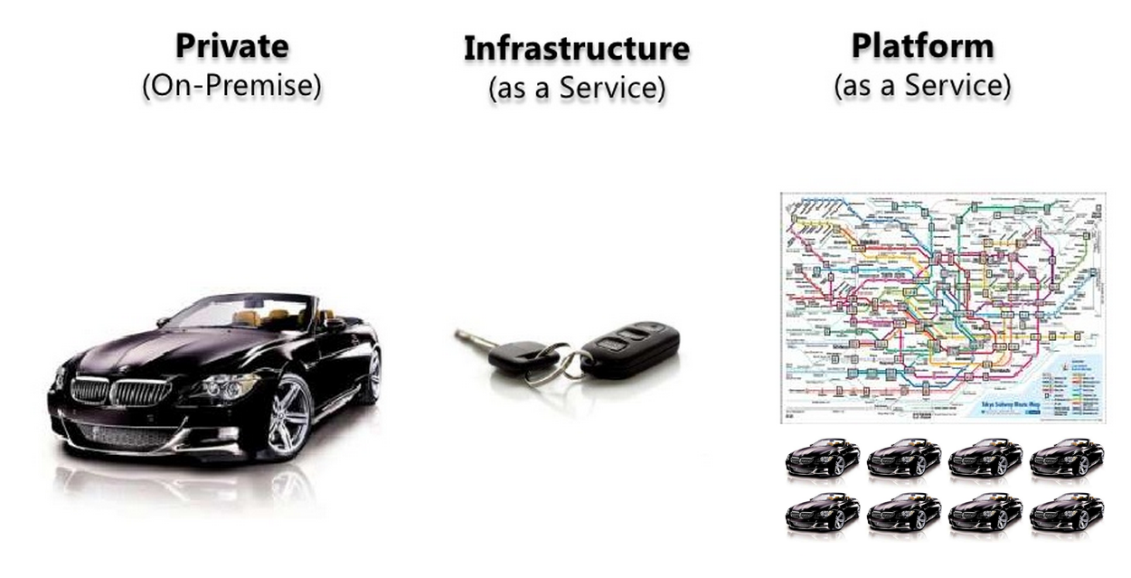
Types of clouds: Platform on prem
Think Local Data Center
Think Amazon (AWS)
Think Azure
With on-prem think AND not OR!
Notes:
But what if you could have the convenience of the Platform story in your own data center most of the time? …and have the ability to push your application to the cloud only when you need to? Effectively don’t throw away your investment in your local datacenter. But also don’t lose the opportunity to burst into the cloud when you need more capacity?

Slide 18
How does Azure and AWS fit?
Infrastructure As A Service (IaaS)
Platform as a Service (Paas)
Two years ago
Amazon Web Services
Microsoft Windows Azure
Now
Amazon Web Services
Microsoft Windows Azure
Notes:
First let’s see where Amazon and Azure started. The time may not be quite accurate but essentially – AWS has always had its eye on offering pluggable pieces at the infrastructure level. Where as Azure has always focused on providing a pointed solution to a specific problem. Collectively they can provide you with a similar outcome.
IaaS is a box of legos you have to assemble – more intensive to manage the bits
Paas is a service that does something really well – less management / harder to assemble something custom
Now they have both reached over the border into infrastructure and platform offerings. However, their roots remain strong in both cases. And their tooling remains aligned with this strategy.

Slide 19

Azure in a box just released!
Platform in your data center
Preconfigured rack
Dell hardware
Microsoft Azure

Slide 20
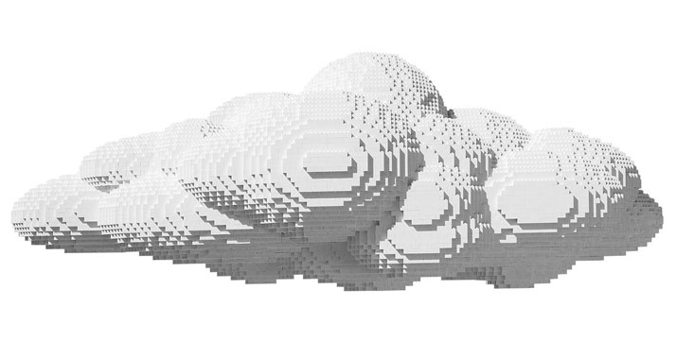
Now lets look into the details
Notes:
Today we will take a look at many of the options that each cloud offers. And get you to a point where you have some idea of the bucket of lego’s that is offered by these two platforms. You will see that in many cases their offerings overlap by about 70-80 percent.

Slide 21
Compute
Notes:
Let’s start with the foundation of a cloud environment. Compute.

Slide 22

Compute
AWS
Azure
Elastic Compute
Elastic Beanstalk
Up to 32 cores, 244GB RAM, 8 x 800GB SSD
High Performance Compute
Load Balancer
Up to 32 cores, 448GB RAM, 16.5TB Disk
InfiniBand – 40Gbit/s RDMA
Notes:
Foundational, computer in cloud, elastic scale, power, purpose
Compute covers the foundational building blocks of both cloud offerings. Think – computer in the cloud. But also think about how you might elastically scale that computer. Also think about how much power do I need in the cloud. And think about the work that you are doing in the cloud. All of these decisions will help you define what to build in the cloud. The less you need – the less you pay.
RDMA – remote direct memory access

Slide 23
Compute
AWS
Azure
General Purpose
Compute Optimized
Memory Optimized
GPU
Storage Optimized
General Purpose
Compute Optimized
Memory Optimized
No GPU – YET! …coming
Storage Optimized
Notes:
AWS - General: baseline CPU with bursting, Compute: high performing CPUs, Memory: High memory, GPU: graphics and GPU intensive compute, Storage: SSD backed
Azure - same short of GPU

Slide 24
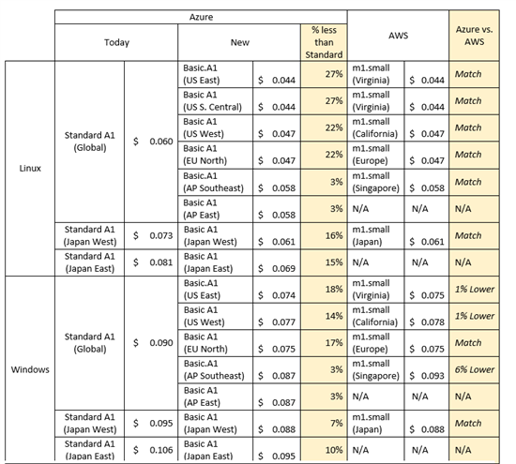
Compute
Notes:
VMs
These prices may not be up to date. That wasn’t important. What I wanted to show you here was the competitive nature of these two providers. They are doing everything possible to stay close to one another on pricing their offerings. There is not a month that goes by where I don’t get an email stating that a service has been heavily discounted from where it once was. They are heavily competing for your business.

Slide 25
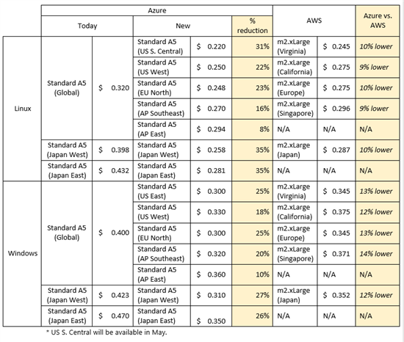
Compute
Notes:
Memory Intensive

Slide 26
Compute
Azure
Worker roles
Web sites
Web jobs
Notes:
Special purpose workers
Worker roles for running services
Web sites for running web sites
Web jobs for background processes in your web site
No updates to manage like in a VM
Specially optimized for the task at hand

Slide 27
Deployment, Management, Automation

Slide 28

Deploy, Manage, Automate
AWS
Azure
Command line support
Visual Studio integration
REST API first
Configuration based supported
Easy to weave into CI
Fully automatable
Web based management portal
Command line support
DEEP Visual Studio integration
REST API available for most things
Configuration based supported
Easy to weave into CI
Fully automatable
Web based management portal

Slide 29
Deploy, Manage, Automate
AWS
Azure
JSON template files
Ruby
Command Line
API
Desired State Configuration
PowerShell
Command Line
API

Slide 30
Deploy, Manage, Automate
AWS
Azure
Management portal is ok
Custom Tooling / API
Management portal is ok
Custom Tooling / API

Slide 31
Deploy, Manage, Automate
AWS
Azure
AWS OpsWorks
Asgard
Chef
Hubot / coffee script
Azure Automation
HA automation engine
PowerShell ready
TFS
Octopus Deploy
MMBOT / scriptcs, .NET

Slide 32
Storage

Slide 33
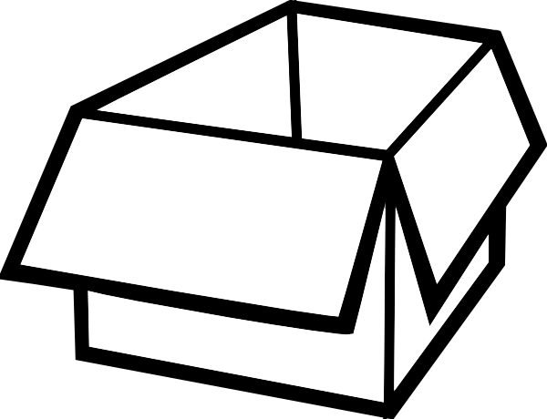
Storage
AWS
Azure
Kinesis
Elastic Map Reduce
SSD backed VMs
Simple Storage Service
Simple DB
Elastic Block Store
Storage Gateway
CloudSearch
DynamoDB
Glacier
Event Hubs
StreamInsight
SSD backed VMs
Azure Blob Storage
Table Storage
Azure File Storage
VPN
Azure Search
DocumentDB
Site to site
Notes:
Data stream ingestion, data stream processing, SSD, blob storage, table storage, queues, file storage, durable disk, local network , search, nosql

Slide 34
Storage
Telemetry data ingestion
Internet of Things sending large amounts of sensor data
Click tracking metrics
Million of events per second
Notes:
Kinesis and Event Hubs

Slide 35
Storage
Process large amounts of data
Ingesting large amounts of data is only awesome if you process it
Reporting
Real time analytics
Click metrics
Notes:
Elastic Map Reduce, streaminsight

Slide 36
Storage
Search all that data
Search first navigation
Faceted searching
Business driven boosted results
Notes:
Cloud search, elastic search

Slide 37
Storage
Unstructured data
Rapid development
Distributed out of the box
High through put
Notes:
DynamoDB, DocumentDB

Slide 38
Storage
Fast I/O
SSD backed VM’s
Notes:
Azure D-Series, G-Series
AWS several offerings

Slide 39
Storage
File Storage
SSD backed VM’s
VPN access to local networks
Notes:
Elastic Block Storage, File Storage

Slide 40
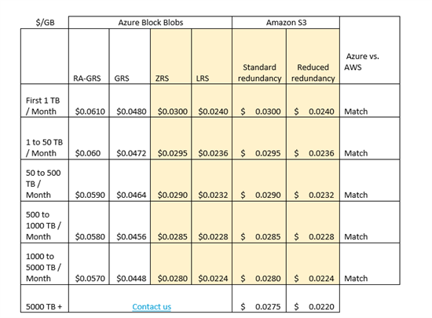
Storage
Notes:
Storage pricing

Slide 41
Messaging

Slide 42

Messaging
AWS
Azure
Simple Queue Service
Simple Workflow
Simple Notification Service
Kinesis
Azure Queue
Service Bus
Twilio (partner)
Event Hubs

Slide 43
Messaging
Queue
Distributed computing
Decouple who does the work

Slide 44
Messaging
Service Bus
Need to coordinate work
Publish subscribe
Workflow/process/saga

Slide 45
Messaging
Telemetry / IoT / High volume
Capture large data
Never lose data
Abstract yourself from volume
Ad campaign
Sensor data
Click tracking

Slide 46
Networking

Slide 47
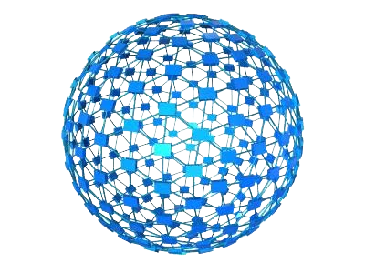
Cloud Infrastructure
AWS
Azure
IP, Elastic IP, Elastic Load Balancer
Virtual Private Cloud
Route 53 (DNS)
Firewall
Direct Connect (VPN)
Virtual Network
Traffic Manager
Azure Load Balancer
No real DNS management
Firewall
InfiniBand – 40Gbit RDMA
Notes:
RDMA - Remote Direct Memory Access

Slide 48
On-prem Infrastructure
AWS
Azure
Directory support
Active directory just released!
Azure pack
Site to site connection
Local to cloud connection
Web based provisioning
Scale up/scale out story
Local usage accounting
Linked active directories
But wait! …there’s more…

Slide 49
On-prem Infrastructure
AWS
Azure
Site to site recovery
Replicate local Hyper-V to the cloud
Recover local from cloud
Remote Apps
office in cloud for mobile devices
Azure in a box!
Dell hardware
Azure platform

Slide 50
Locations
AWS
Azure
N. Virginia
Oregon
N. California
Ireland
Singapore
Tokyo
Sydney
São Palo
GovCloud
N. Central US
S. Central US
W. US
E. US
N. Europe
W. Europe
E. Asia
SE. Asia

Slide 51
Locations
AWS
Azure
Regions
Zones
Regions
Availability Sets
Update Domain
Fault Domain

Slide 52
Email

Slide 53

Email
AWS
Azure
Simple Email Service
Outbound only
Free: 62k emails
Great if send only
Integrates with other services
SendGrid could be used here too
SendGrid
Free: 25k emails
Inbound
Outbound
Great for marketing efforts
More feature rich
Notes:
SES allows you to send lots of email. It offers simple notifications around failures and the like. But that is pretty much it.
Azure doesn’t really have any built in tooling for sending email. Instead it partnered with SendGrid. Which has a rich set of features for sending, receiving, parsing, analytics, click tracking, etc.

Slide 54
Email
Neither Azure or AWS has a good “manage my business email” in the cloud story
You can set up an SMTP/POP3/IMAP in both easily
But wait - Microsoft Office 365
STMP/POP3/IMAP
Awesome integration with Office

Slide 55
Security

Slide 56

Security
AWS
Azure
ISO 27001
PCI DSS
DIACAP Level 2
FISMA
FedRAMP
Government Cloud
ISO 27001
PCI DSS
HIPPA
SSAE 16
Cloud Security Alliance
FedRAMP
CJIS
Azure Government (preview)
Notes:
I always get bogged down here. So we will have to read the upcoming slides a bit. I highlighted the key spots to make this easier.
We all likely know what is important to us.
PCI – credit card handling?
HIPPA – sensitive patient data?
ISO 27001 – organizational information risk management?

Slide 57
Security
PCI DSS
The Payment Card Industry Data Security Standard is a proprietary information security standard for organizations that handle branded credit cards from the major card brands including Visa, Master Card, American Express, Discover, and JCB. Private label cards, those without a logo from a major card brand are not included in the scope of the PCI DSS.

Slide 58
Security
HIPPA
Health Insurance Portability and Accountability Act sets the standard for protecting sensitive patient data. Any company that deals with protected health information (PHI) must ensure that all the required physical, network, and process security measures are in place and followed.

Slide 59
Security
ISO 27001
A specification for an information security management system (ISMS). An ISMS is a framework of policies and procedures that includes all legal, physical and technical controls involved in an organization's information risk management processes.

Slide 60
Security
DIACAP Level 2
The DoD Information Assurance Certification and Accreditation Process is a United States Department of Defense process that means to ensure that companies and organizations apply risk management to information systems. DIACAP defines a DoD-wide formal and standard set of activities, general tasks and a management structure process for the certification and accreditation of a DoD IS that maintains the information assurance posture throughout the system’s life cycle.

Slide 61
Security
FISMA
The Federal Information Security Management Act (FISMA) is United States legislation that defines a comprehensive framework to protect government information, operations and assets against natural or man-made threats.

Slide 62
Security
FedRAMP
The Federal Risk and Authorization management program (FedRAMP) is a government-wide program that provides a standardized approach to security assessment, authorization, and continuous monitoring for cloud products and services.

Slide 63
Security
SSAE 16
Statement on Standards for Attestation Engagements is a regulation created by the Auditing Standards Board (ASB) of the American Institute of Certified Public Accountants (AICPA) for redefining and updating how service companies report on compliance controls.

Slide 64
Security
Cloud Security Alliance
The Cloud Security Alliance (CSA) is a not-for-profit organization with a mission to promote the use of best practices for providing security assurance within Cloud Computing, and to provide education on the uses of Cloud Computing to help secure all other forms of computing. The Cloud Security Alliance is led by a broad coalition of industry practitioners, corporations, associations and other key stakeholders.

Slide 65
Security
CJIS
The Criminal Justice Information Services security policy is to provide appropriate controls to protect the full lifecycle of criminal justice information, whether at rest or in transit.

Slide 66
Security
Government
Physical and network isolation from non-U.S. government deployments
Requires specialized personnel screening

Slide 67
Operating System & Data Transfer

Slide 68

OS & Data
AWS
Azure
CentOS
Debian
Ubuntu
FreeBSD
RedHat
Windows
Windows
CentOS
Ubuntu
SUSE
Notes:
There are a bunch of canned operating systems available in both environments. AWS has a strong linux offering. But custom images can be created in both environments easily.

Slide 69
OS & Data
AWS
Azure
Drupal
Apache
PrestaShop
Bugzilla
Discourse
ZenCart
WordPress
Drupal
Apache
Bakery (web template)
BugNET
MVC Forum
OpenCart
WordPress
Notes:
But what is more interesting is that you can pick purpose built installations of operation system plus Application

Slide 70
OS & Data
AWS
Azure
Data into the data center is free
Data out is paid
Data into the data center is free
Data out is paid
Data moving internally is free
in the same data center
Check the rates for each service you use.
Rates vary significantly!
And change often!

Slide 71
OS & Data
AWS
Azure
AWS Import/Export
Physical storage devices
To and from data center
S3 Buckets (blob)
EBS snapshots (images)
Glacier (cold storage)
Import/Export Service
Physical storage devices
To and from data center
Azure Blob storage

Slide 72
Development Languages & Runtime Support

Slide 73

Languages & Runtimes
AWS
Azure
Java
Python
Ruby
Node.js
Php
PowerShell
.NET
Java
Python
Ruby
Node.js
Php
PowerShell
.NET
Notes:
There are many languages on both platforms.

Slide 74
Languages & Runtimes
AWS
Azure
Visual studio integration
Many SDKs available
Command line tooling
REST APIs
Great documentation
Deep visual studio integration
Many SDKs available
Command line tooling
REST APIs
Great documentation
Community contrib model
Notes:
And each of these platforms provide lots of tooling for most of these languages. And where there isn’t direct language support there is a command line tool. And where the command line tools don’t work there is a REST API. This is generally enough.

Slide 75
Languages & Runtimes
AWS
Azure
Word Press
Joomla
Droopal
And many many more…
Word Press
Joomla
Droopal
And many many more…

Slide 76
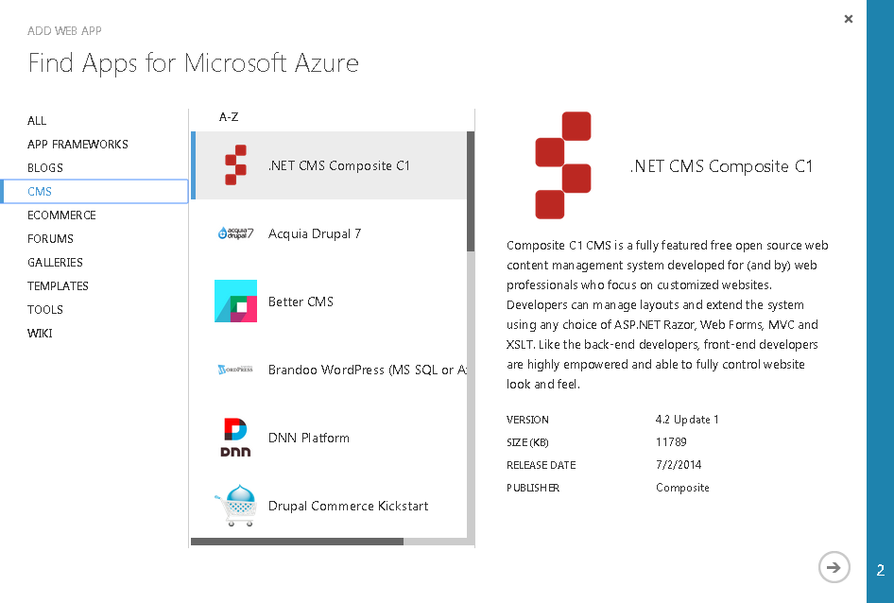
Languages & Runtimes

Slide 77
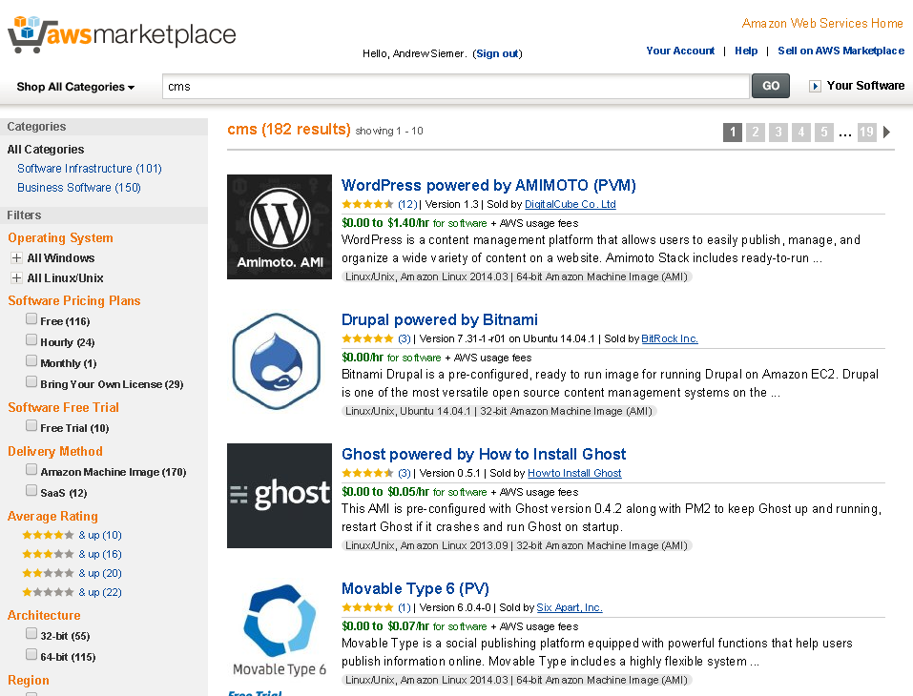
Languages & Runtimes

Slide 78
Questions?
Andrew Siemer - Clear Measure
andrew@clear-measure.com
(512) 387-1976
@asiemer

